Slide 1
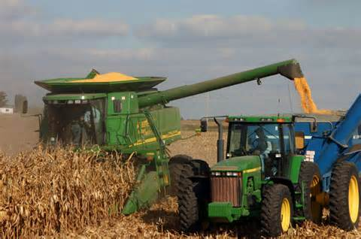

Innovation in Agriculture
Then & Now

Slide 2
What is
Agriculture?

Slide 3
ag·ri·cul·ture noun \ˈa-gri-ˌkəl-chər\
Dictionary Definition:
The science, art, or practice of cultivating the soil, producing crops, and raising livestock and in varying degrees the preparation and marketing of the resulting products.
In Simpler Terms:
Everything involved with growing plants and animals to be used for something else.

Slide 4
Where is STEM in Agriculture?
Science - Technology
Engineering - Math
Notes:
Ask students what experience they have planting or harvesting corn? Ask them what they think it entails. Ask what they think it entailed 40 years ago. 60 years ago. 150 years ago?
Where & how is STEM involved?
Have them think about the impacts of agricultural innovations. Why does it matter? Who does technological advances help?

Slide 5
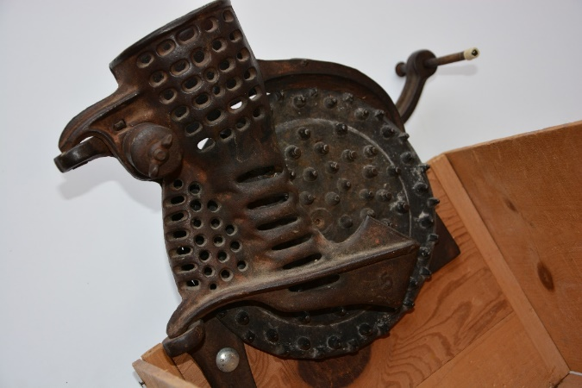
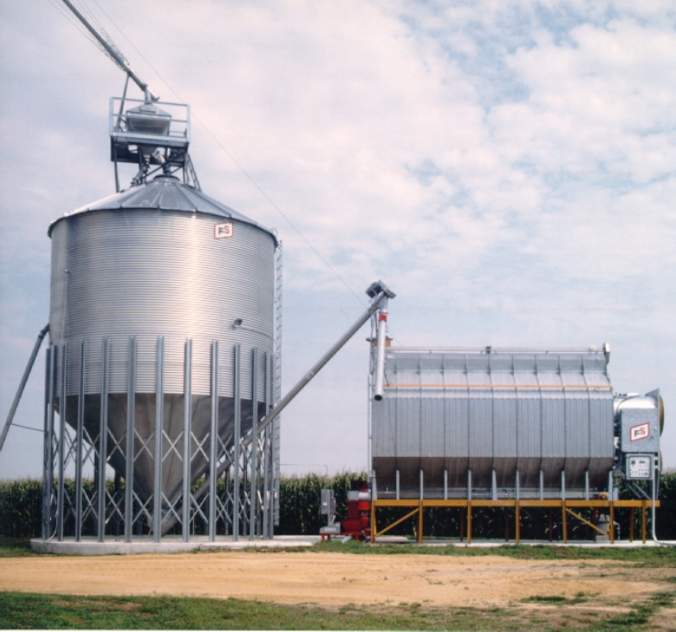
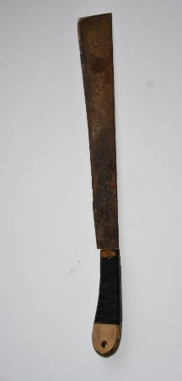
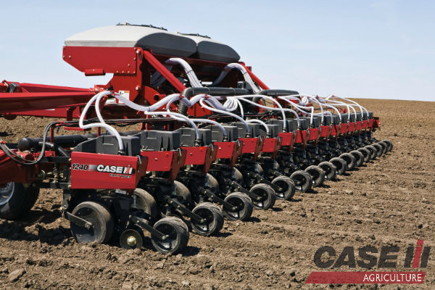
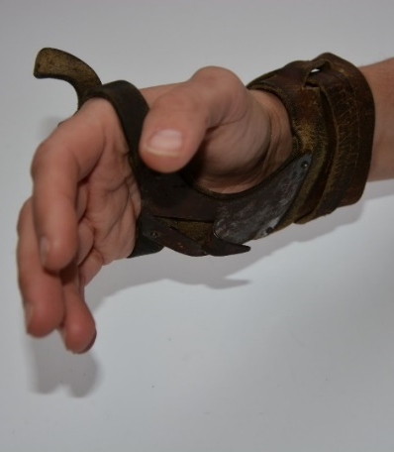
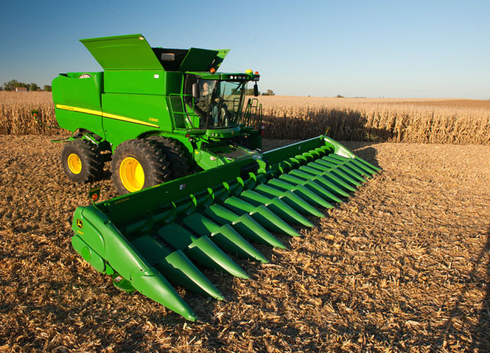
Farm Machines
Long Ago & Today

Slide 6
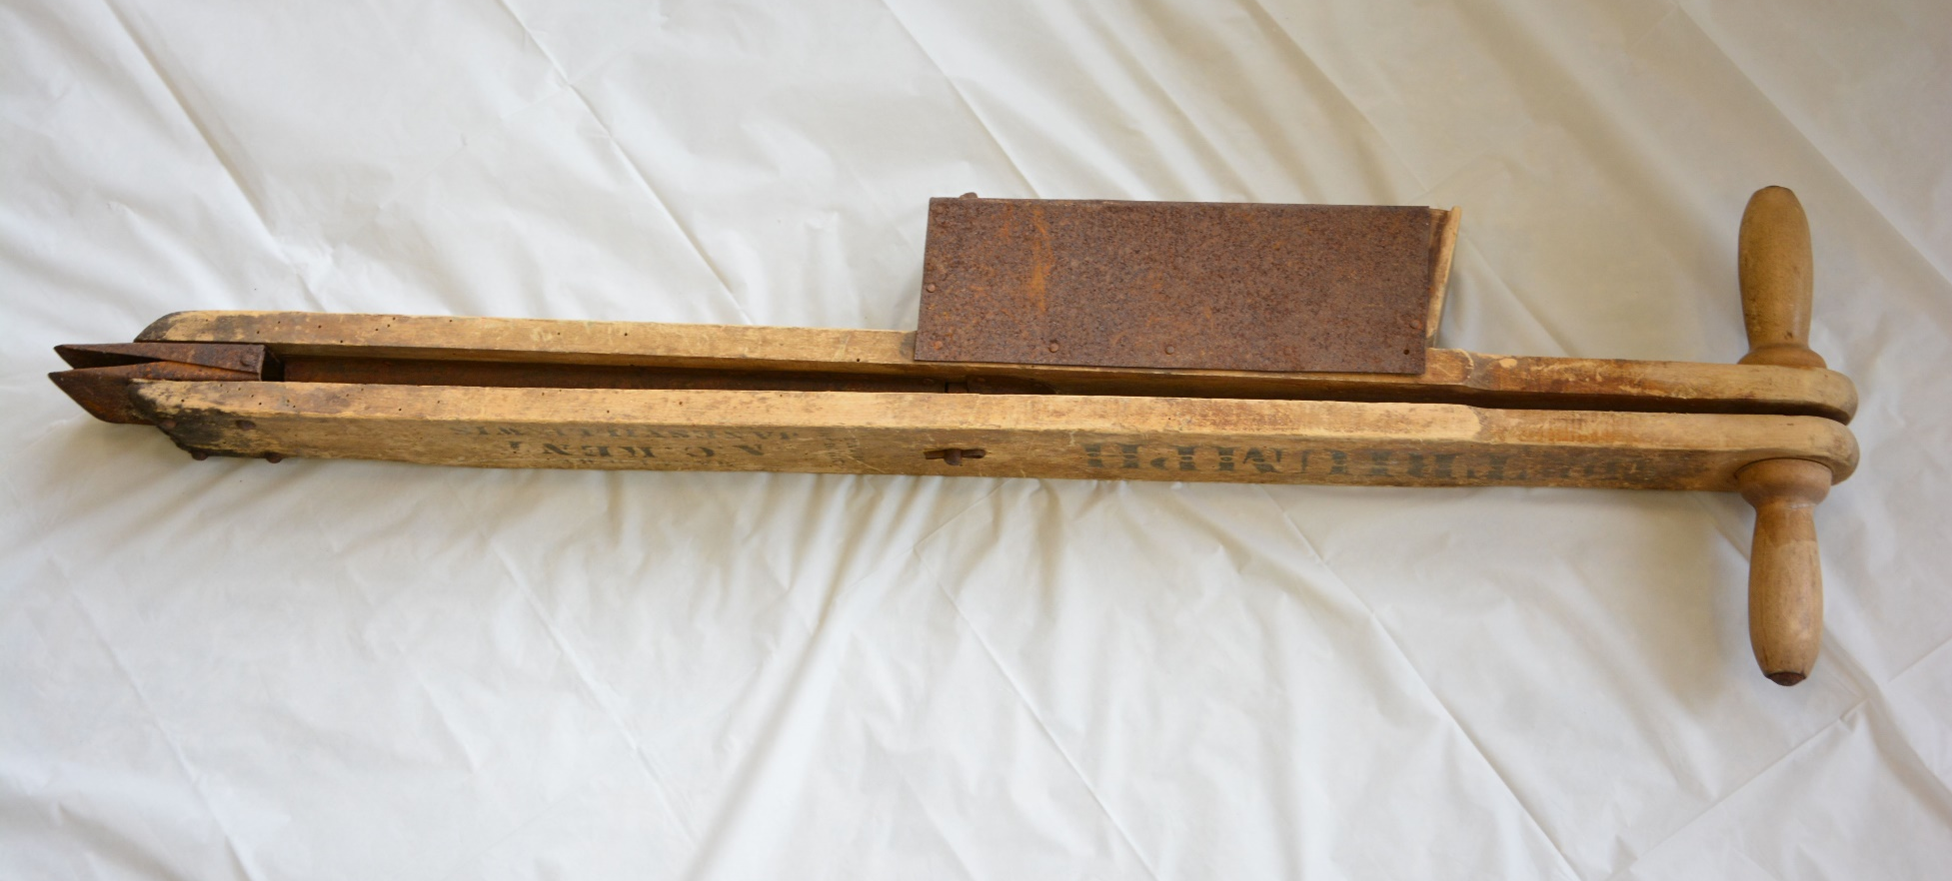
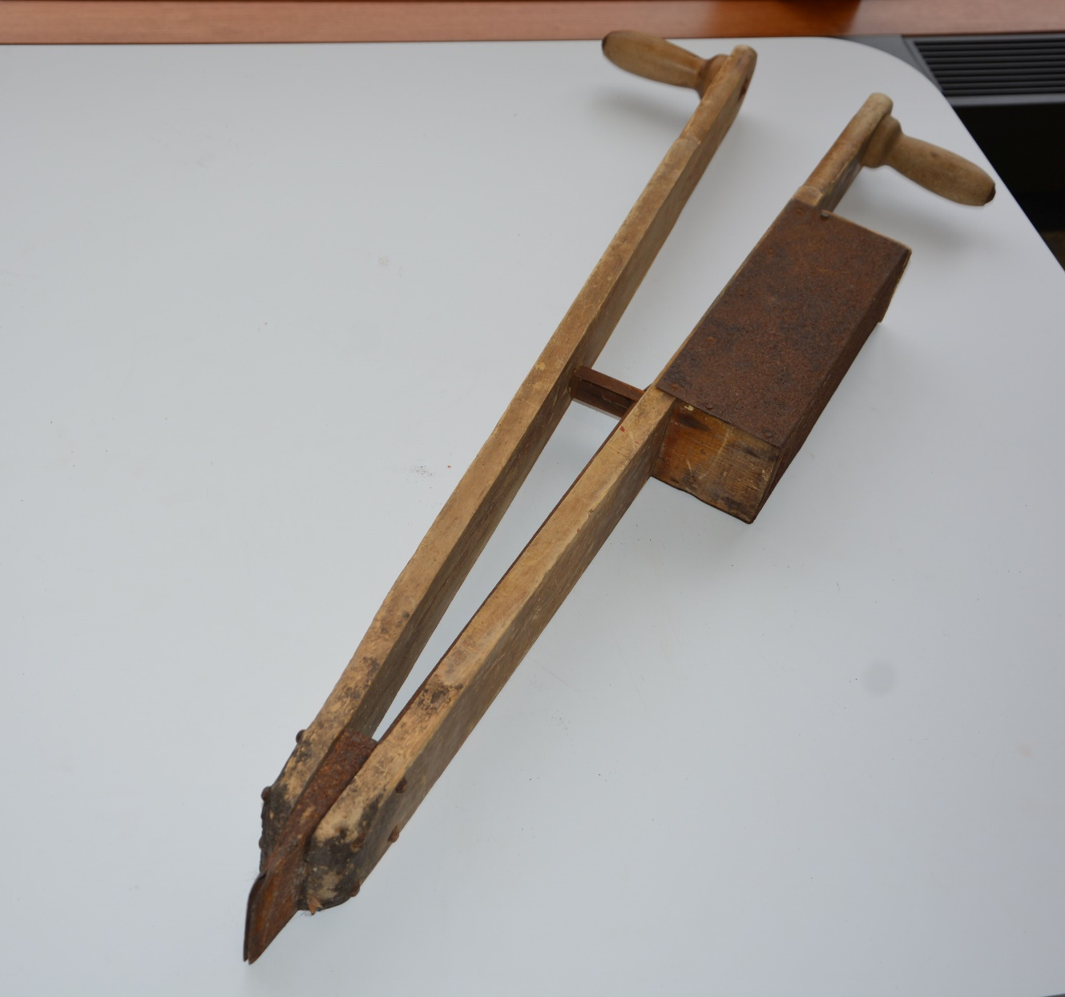
What would this gadget do?

Slide 7
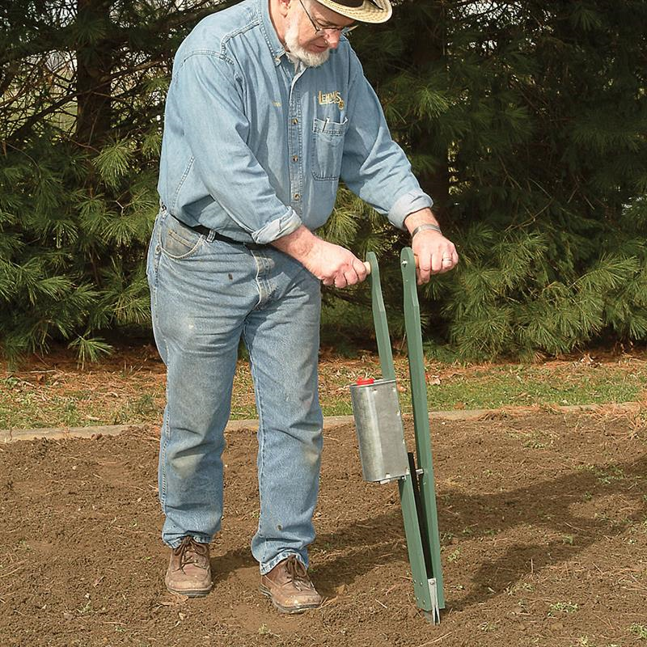
It’s a planter!
Seeds would be placed in the box and dropped into the furrow as the handles are pushed together.
The tip at the bottom opens as the handles are pushed together to create a better pocket for the seed.
Notes:
Photo source: https://www.lehmans.com/p-2926-lehmans-own-old-fashioned-corn-planter.aspx?show=all

Slide 8
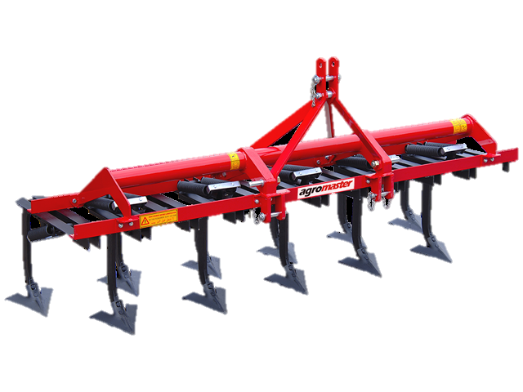
Modern equivalent?
2
1
3
4

Slide 9
Planter
Modern planters are pulled behind tractors, and have large tanks to store seed.
The wheels and disks at the bottom of the planter help create a furrow for the seed and cover the seed back up.
Notes:
Though the newest planters use seed tanks, many farmers still use planters with boxes for seed on each planting unit. Overall, today’s equipment uses many kinds of technology to help farmers best use their land and resources. Planters can use variable rate technology and other precision planting technology to ensure that certain areas of the field are not planted twice, or even plant certain seed types in specific places of a field. Though not all of this technology is normalized yet, producers and implement dealers continue to make strides toward the ideal precision planting scenario.
Photo source: http://partstore.caseih.com/us/1240-early-riser-planter-parts-catalog-a304.html

Slide 10
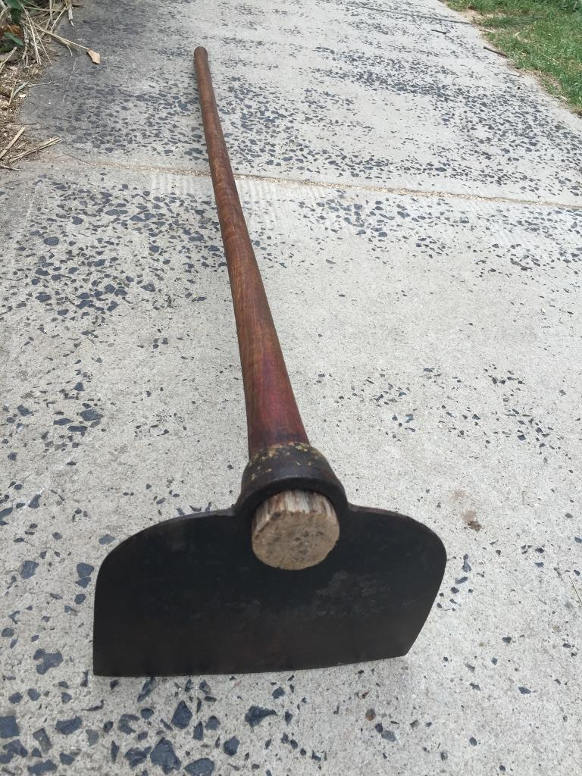
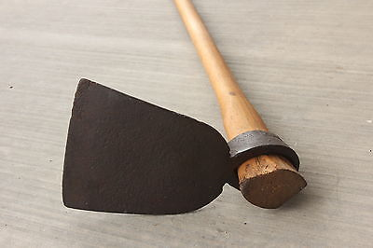
What is this used for?
Notes:
Photo sources: http://theantiquestore.com.au/p/9036622/large-antique-elweel-timber-cast-iron-farmer-garden-hoe-tool-a1-condition.html, http://www.ebay.com/itm/360764132281

Slide 11
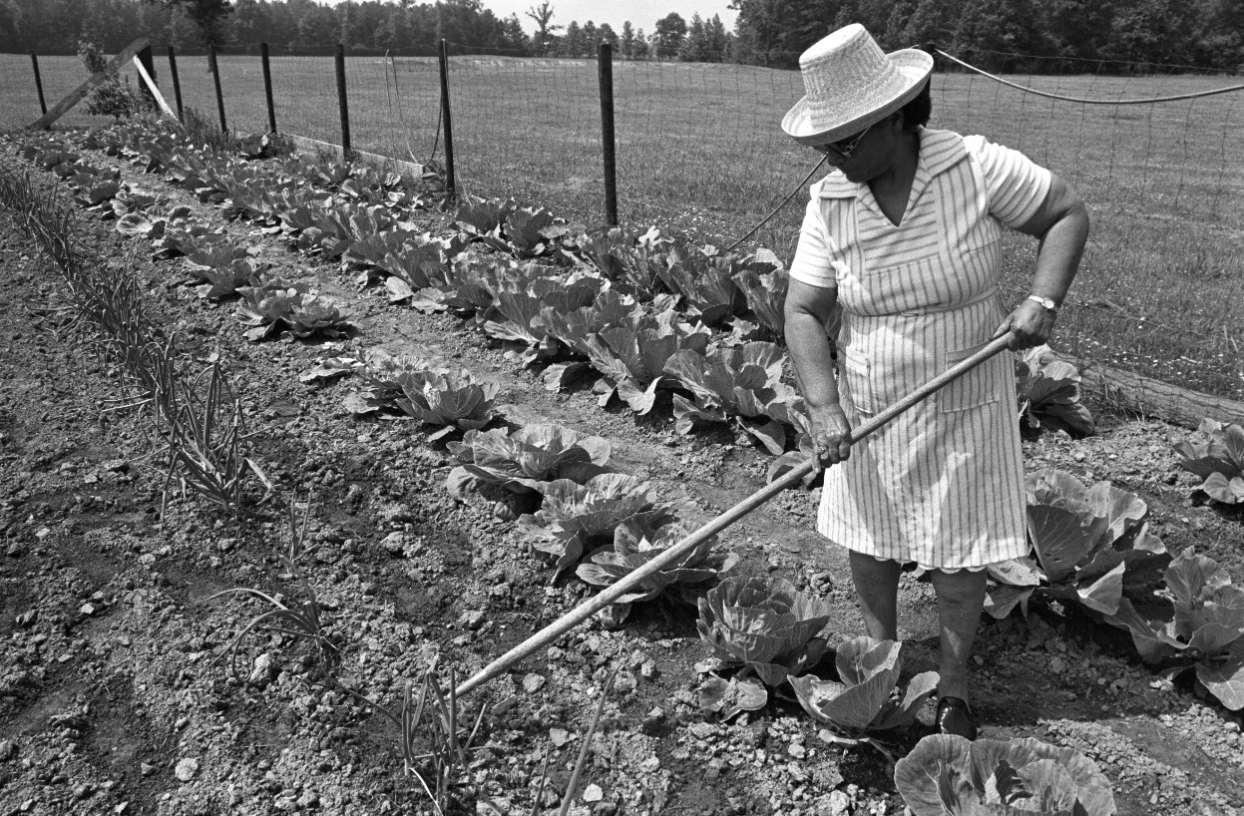
It’s a garden hoe!
People have been using tools like these to cultivate their seed beds for a long time.
Garden hoes can break down soil clumps, dig rows for planting, cover seed, and remove weeds from the seed bed.
Notes:
Photo source: USDA archives

Slide 12
Modern equivalent?
2
1
3
4

Slide 13
Field Cultivator
Today, farmers pull tillage equipment like field cultivators behind their tractor to prepare the seedbed for planting or to kill unwanted weeds in their field.
The cultivator pictured has V-shaped sweeps. Why do you think that is?
Notes:
The shape of the sweep helps to cut roots (of weeds) below the soil surface, while hopefully keeping the soil on the surface relatively intact. This is a way some farmers try to conserve their soil (practices like these can be called minimum tillage, or conservation tillage).
Note: There are many, many types of tools that farmers can use to till their fields. Discs, harrows, and field cultivators are maybe the most common, but each of those can have variations or additional attachments that can make them look different. The important concept is that now farmers do not have to use a garden hoe in their fields and cultivate by hand.
Photo source: http://www.agromaster.com.tr/cultivators/tubular-frame-cultivator/

Slide 14
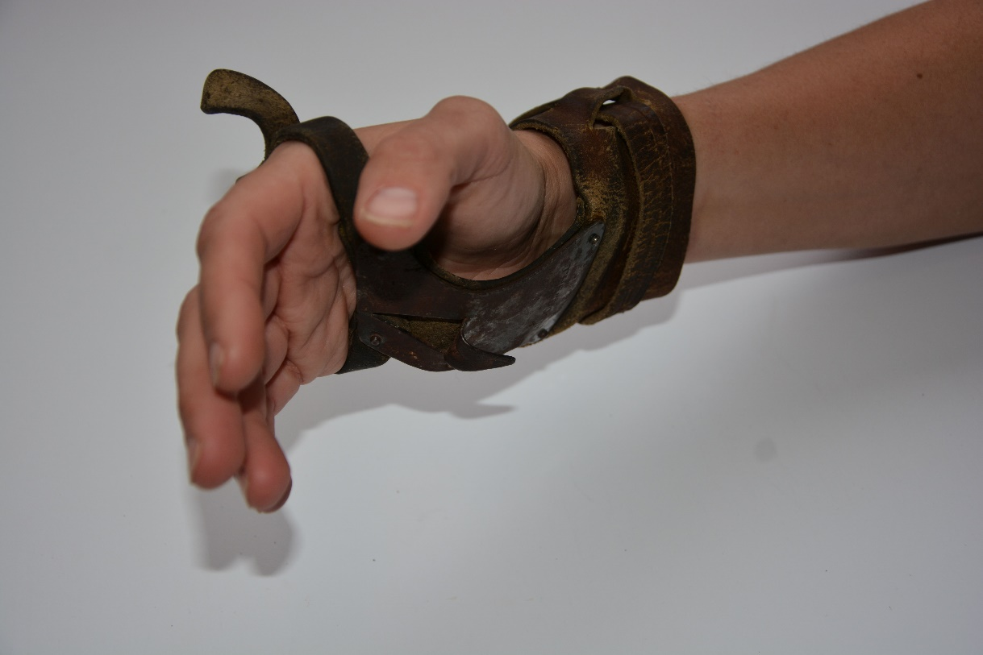
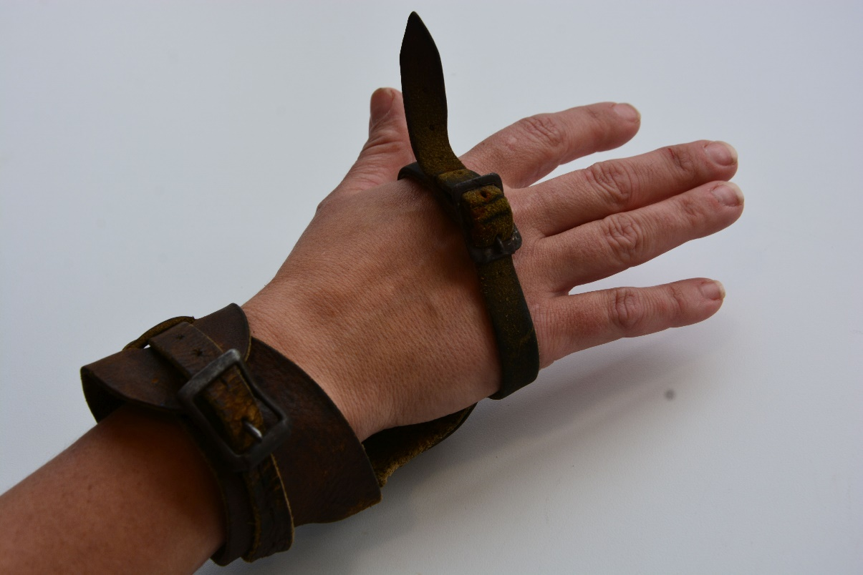
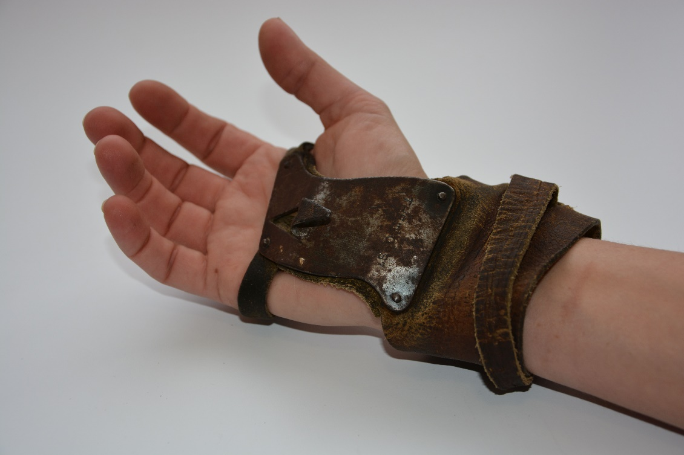
What is this tool?

Slide 15
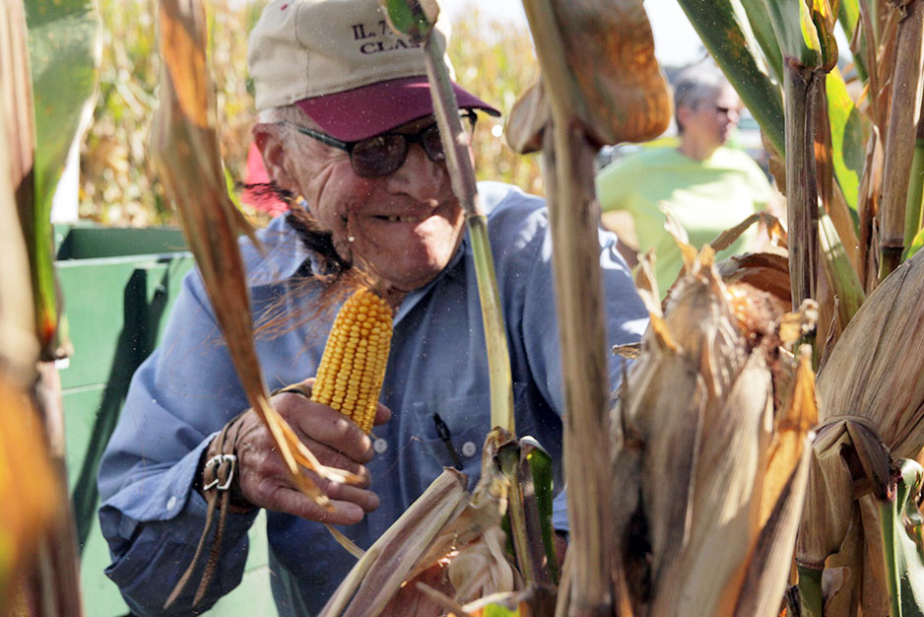
It’s a corn-husking glove!
When corn was picked by hand, this made it easier to pick the ear and husk it in one motion!
When used correctly, the hook in the center of the glove could tear the husks off the corn and pick the ear from the stalk. Then, the cob would be thrown in the wagon behind the worker.
Notes:
Photo source and article: http://indianapublicmedia.org/eartheats/harvest-corn-huskers-pick-hand/
How to use a husking glove (gif): http://rockymountaincorn.com/blogs/how-to/16323000-shucking
Excellent video: https://www.youtube.com/watch?v=suy0kGnQXeI

Slide 16
Modern equivalent?
2
1
3
4

Slide 17
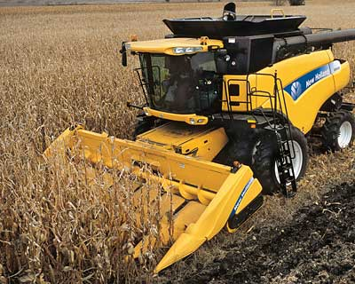
Combine
Today, the combine takes care of many harvesting jobs.
The combine will cut down the stalks, pick the ear from the stalk, husk the corn, and shell the corn, before dispensing it into a wagon nearby.
Combines can harvest up to 18 rows at once, and drive about 3-4 miles per hour.
Notes:
Exact speed will depend on crop specie, climate, terrain, combine, etc. But they definitely do not go highway speeds while harvesting.
Resources:
How do Combine Harvesters Work?: http://www.explainthatstuff.com/howcombineharvesterswork.html (good visual and vocab)
Combine Settings for Minimal Harvest Loss: http://extension.agron.iastate.edu/soybean/production_combineset.html

Slide 18

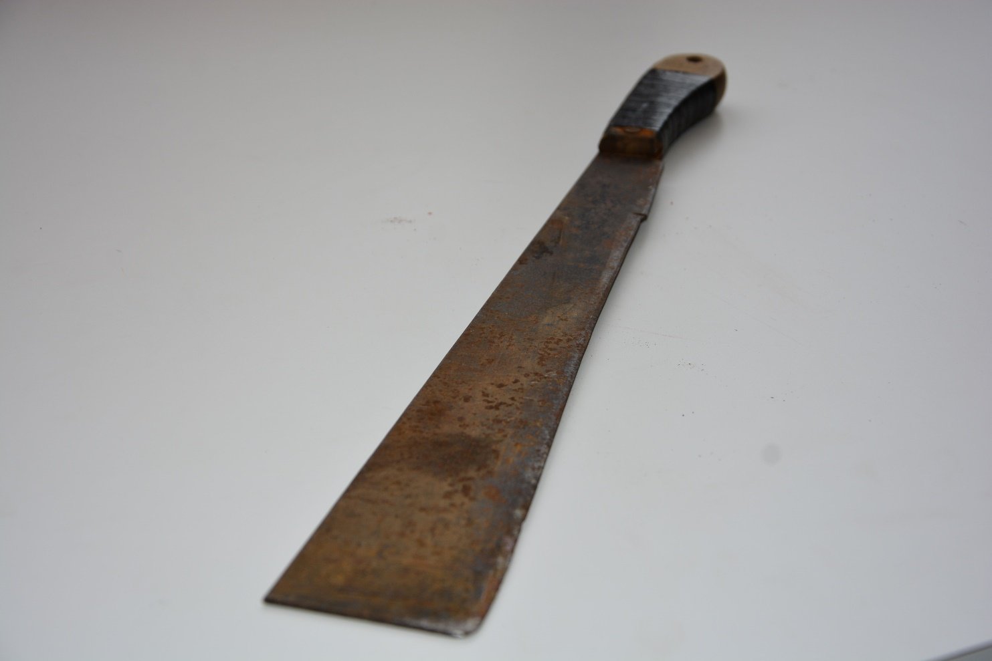
How would farmers use this?

Slide 19
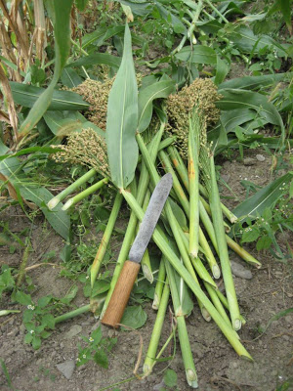
It’s a corn knife!
This broad knife helped farmers cut corn stalks down.
Though many corn knives had straight blades like this one, others may have had curves.
Think about how different shaped blades helped farmers do different things. Why is that?
Notes:
You can have students think about sickles or scythes and how they differ from the corn knife. How farmers use them differs pretty greatly, because the hooked blades are better for lighter cereal grains (like wheat), and the corn knife is broad and blunt to break the thick corn stalks.
Cutting stalks could have multiple purposes; to clear the field after harvest, or to cut the whole stalk (ears included) to store for silage (a type of cattle feed).
Photos: http://thefarmersmuseum.blogspot.com/2010/11/broom-corn-harvest.html

Slide 20
Modern equivalent?
2
1
3
4

Slide 21
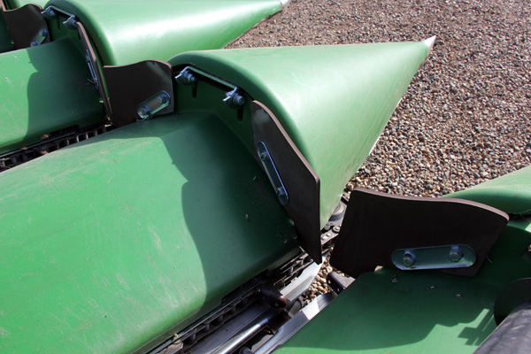
Combine
Today, farmers can use a combine to harvest, as well as cut down the remaining corn stalks.
In the lower photo, you can see the head of the combine more closely. The corn stalks would be fed in between those fingers, and cut before being fed into the machine.
Notes:
There are many different kinds of combines. For instance, a potato harvesting looks much different than this. However, in Iowa we generally see two main kinds of combines; those with corn heads (pictured above, recognizable by the “fingers”) and those with soybean heads (think of the combine Frank from Cars; he head has reels that rotate down like a Ferris wheel and feed the plant’s stem into a cutter bar and auger). Generally speaking, farmers can change the header on their combine, and then harvest a different crop.
Photo source: http://www.grainews.ca/2014/04/09/in-the-field-evaluating-a-capello-header/
Soybean combining explained (similar to small grains like wheat): http://windowontheprairie.com/tag/combine-soybeans/

Slide 22

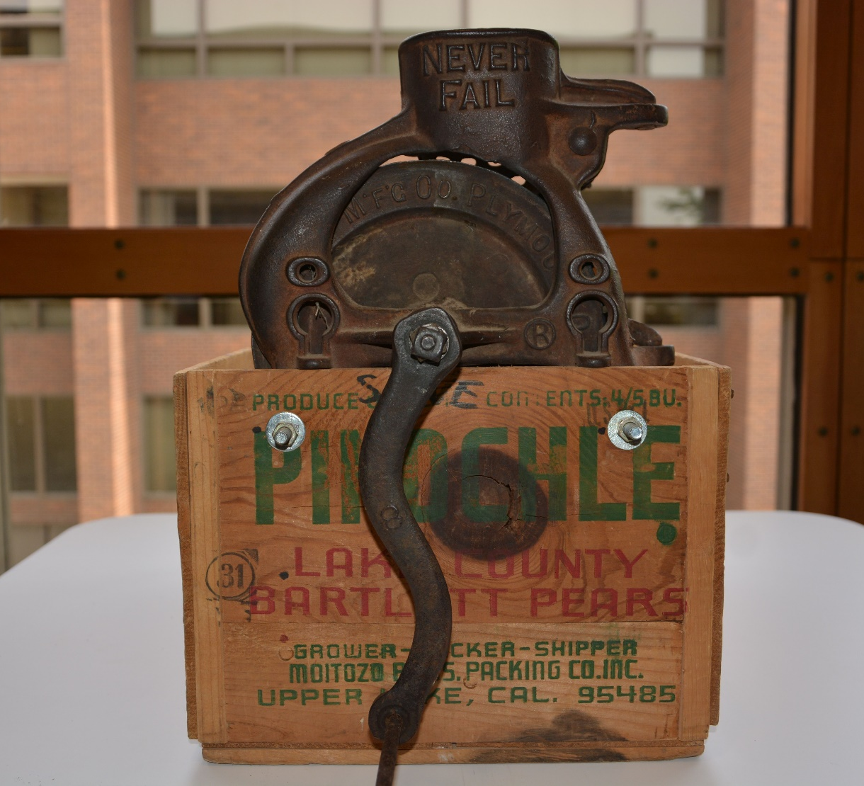
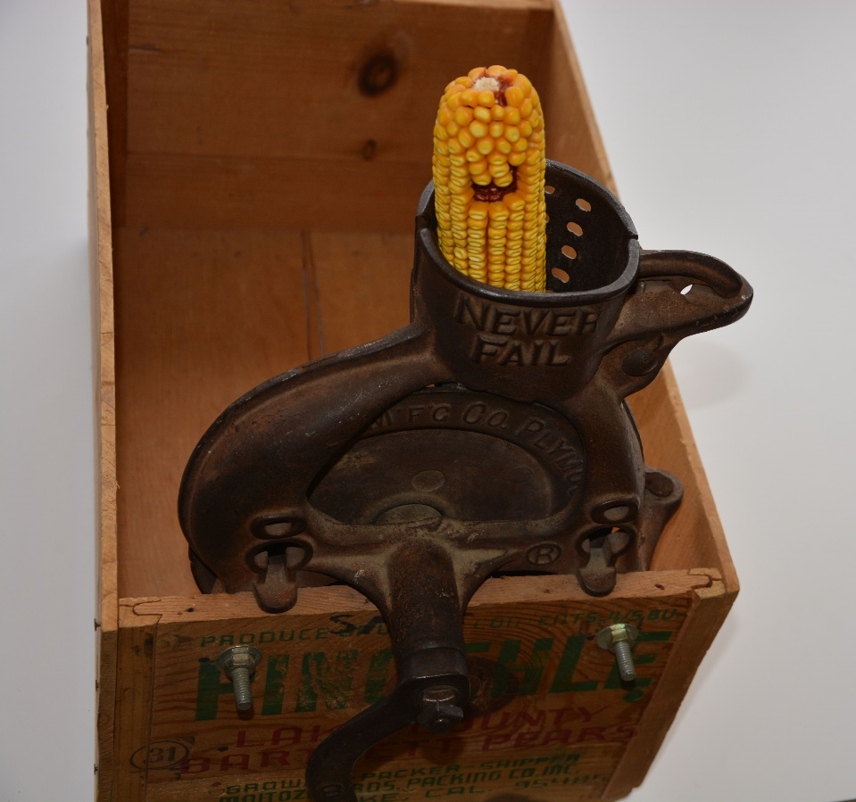
What would this machine do?

Slide 23
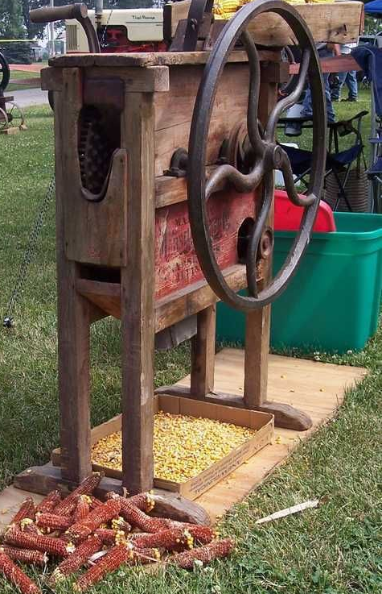
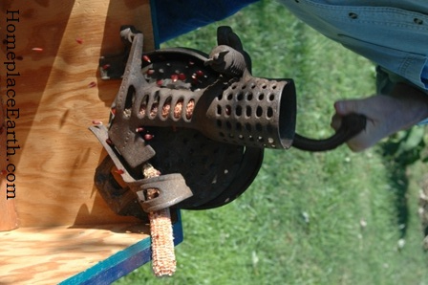
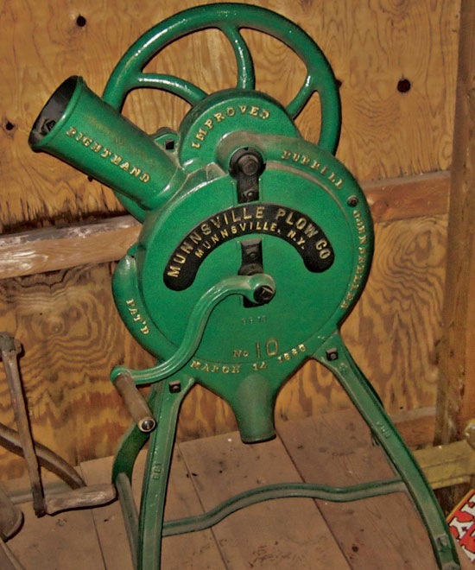
It’s a corn sheller!
Shelling corn (or picking the kernels off the cob) is hard work! This machine would take the kernels off the cob with ease!
Though there were many types of corn shellers, hand crank styles were popular.
What do you think is inside the cone that helps the kernels fall off?
Notes:
URL of above video: https://www.youtube.com/watch?v=gaEd4JncTDU
Slideshow of various styles of corn shellers: http://www.farmcollector.com/equipment/corn-collectibles-corn-shellers.aspx?SlideShow=1
Detailed blog post on hand-crank sheller: http://www.5acresandadream.com/2013/02/corn-sheller.html
Corn shellers have various types of teeth that help jostle the kernels from the cob.
Shelling can also be referred to as “threshing”

Slide 24
Modern equivalent?
2
1
3
4

Slide 25
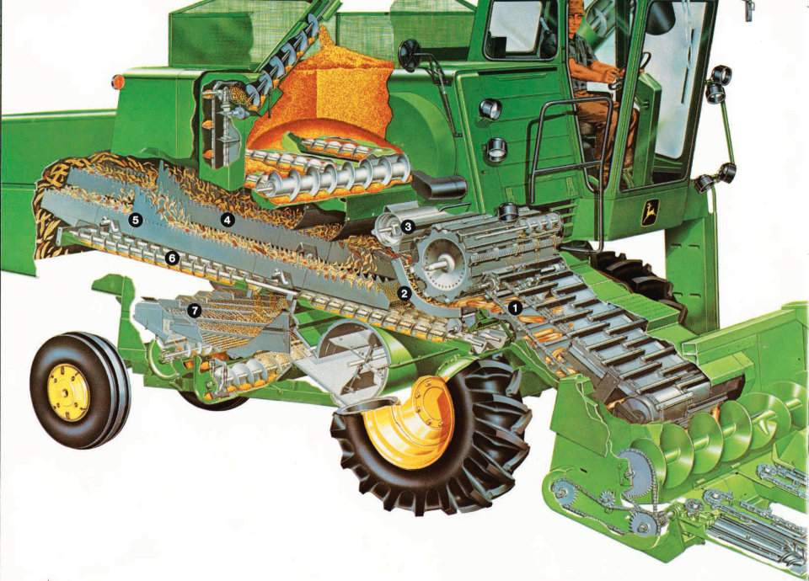
Combine
In this photo you can see where the husks and kernels are removed from the cob, and how they are sorted out.
What benefits are there to putting the husks and cobs back onto the field (#5)?
Notes:
Extra organic material (like corn husks, cobs, and stover) is good for the soil. It helps the soil hold more nutrients, and overall increases soil health – which is important to keep growing plants!
How Stuff Works: Episode 1: Corn Combine (video): https://www.youtube.com/watch?v=u2AvESRQRsg

Slide 26
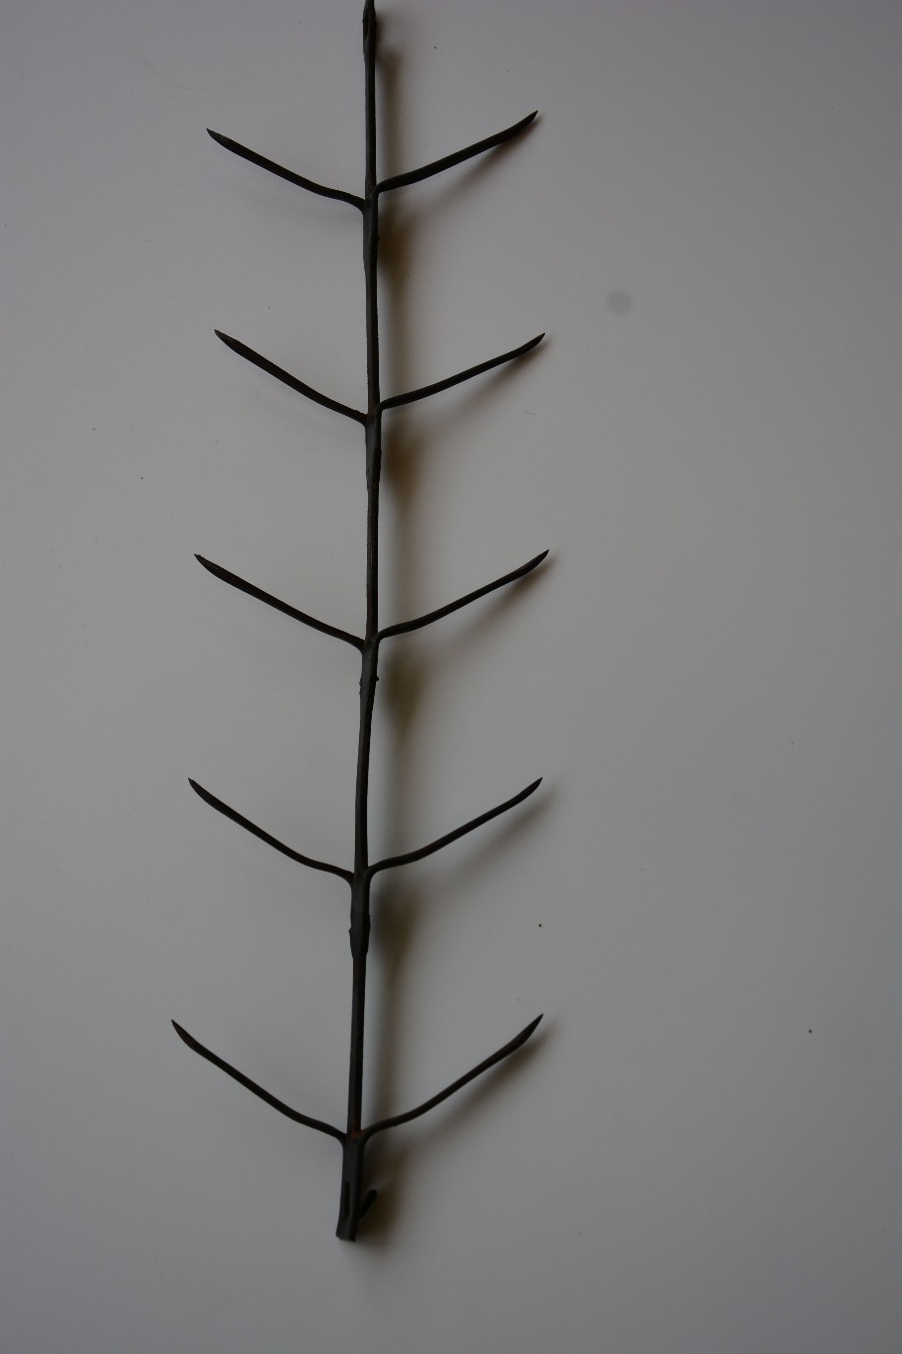
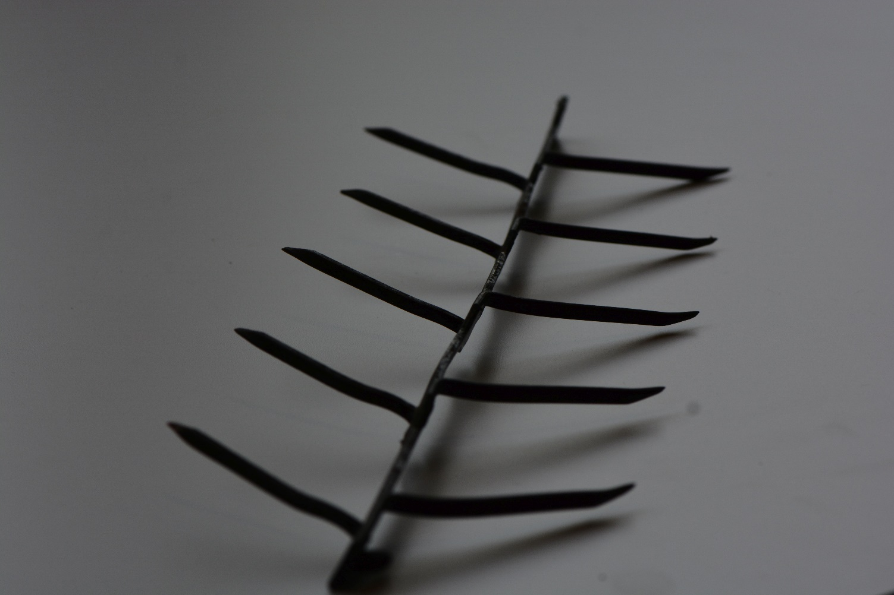
What does this tool do?

Slide 27
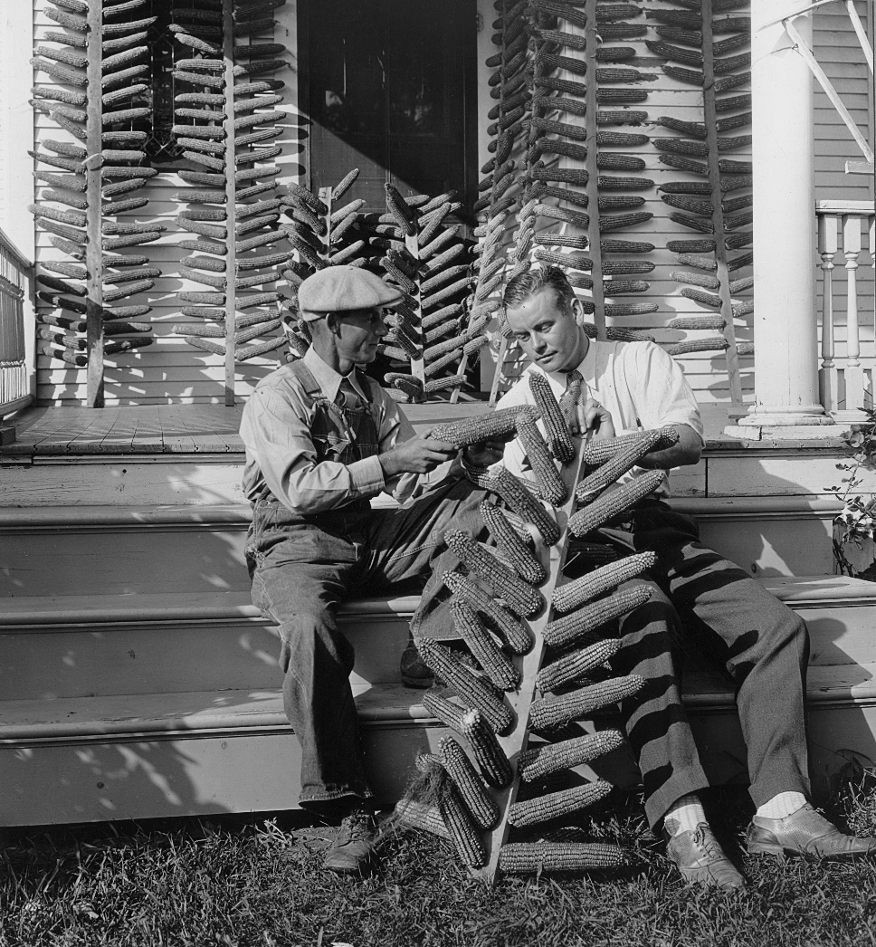
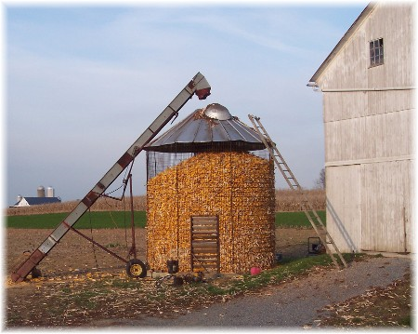
It’s an antique corn dryer!
In order to store grain for long periods of time, drying it has been a common practice for a long time.
This tool would hold ears of corn and allow them to dry.
For larger amounts of corn, producers also used corn cribs, which were large huts with plenty of holes so the grain could dry on the cob.
Notes:
While corn cribs may still be in use in some places, generally producers have opted to use more grain bins (in next slide).
Photo sources: USDA archives, http://www.scrapmetalforum.com/day-life-scrapper/8447-corn-silos-scrap.html

Slide 28
Modern equivalent?
2
1
3
4

Slide 29
Mechanical Grain Dryer
Today, grain dryers will be used to dry corn kernels after they are off the cob.
Grain dryers will generally push air through the bottom of the bin, and use augers to push dry grain to the top, allowing wet grain to reach the airflow at the bottom.
Notes:
Producers generally try to dry their corn to about 10-13% moisture for the best storage.
Resources: http://cornandsoybeandigest.com/corn/top-tips-successful-summer-grain-storage
How a Grain Dryer Works (video): https://www.youtube.com/watch?v=jTIKcdGjyH4
Centerflow Grain Dryer System (video): https://www.youtube.com/watch?v=6HSelg-vTf0

Slide 30
Summary
Antique tools
Modern tools
Hand planter
Garden hoe
Corn husking glove
Corn knife
Corn sheller
Corn dryer
Mechanical planter
Field cultivator
Combine harvester
Mechanical grain dryer
Notes:
Color denotes the equivalents on the antique and modern tools

Slide 31
Where is STEM in Agriculture?
Science - Technology
Engineering - Math

